Slide 1
TAG WEB APP
INSTRUCTIONS

Slide 2
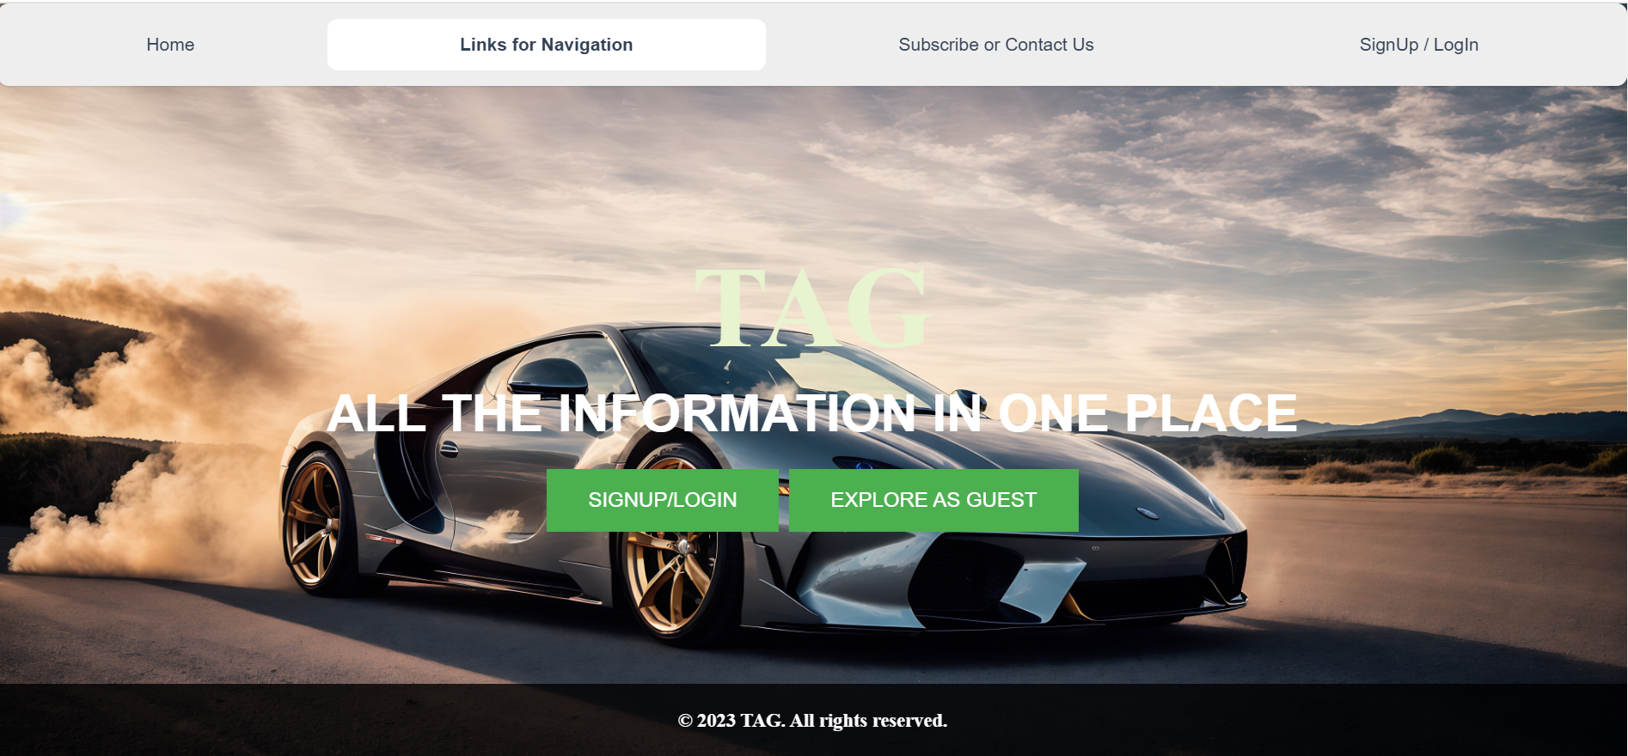
Access the TAG Website:
Open your preferred web browser.
Navigate to the TAG website (Link: HOME)
User can either signup/login or can explore as a guest without login.

Slide 3

Explore As guest:
Users can either submit a ‘New form’ to get tailored recommendations or ‘explore all available car options’ and Information available.
New form option:
Fill out the form with your financial requirements, preferences, and intended vehicle details.
After form submission, you will be redirected to a page with personalized recommendations based on your input.
Explore All option:
Self Explanatory.

Slide 4
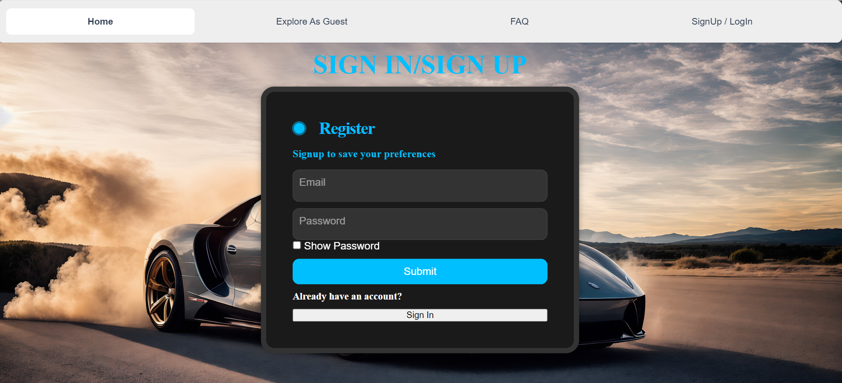
SIGNUP/SIGNIN option:
Click on Sign-In:
On the home page, locate and click on the "SignUp/Login" button.
Register:
Enter a valid email address and any password. Now, click on submit to redirect to verification page
After Verification, you will be redirected to the home page.
Sign In:
If you already have an account, Click on the "Sign In" button to access your account.

Slide 5
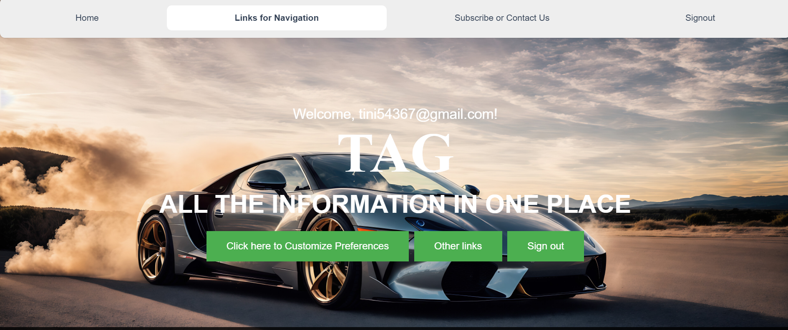

After signing in, Use ‘click here to customize preferences’ button for form submission or saving the data.
Use ‘Other links’ option to navigate to other pages like ‘explore all options’ or ‘weekly recommendations’.

Slide 6

Navigate to “subscribe or contact us”.
Subscribe:
User can subscribe to weekly recommendation.
Contact Us:
User can fill out their information to be contacted by us.
About Us:
About the website and team.
FAQ:
Has answers to frequently asked questions.

